Slide 1


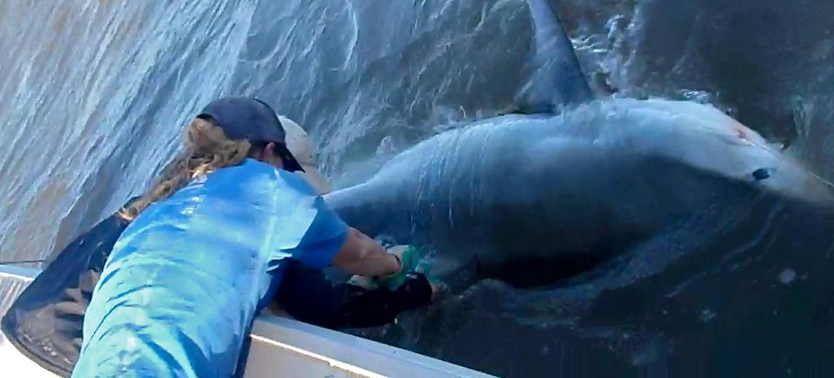
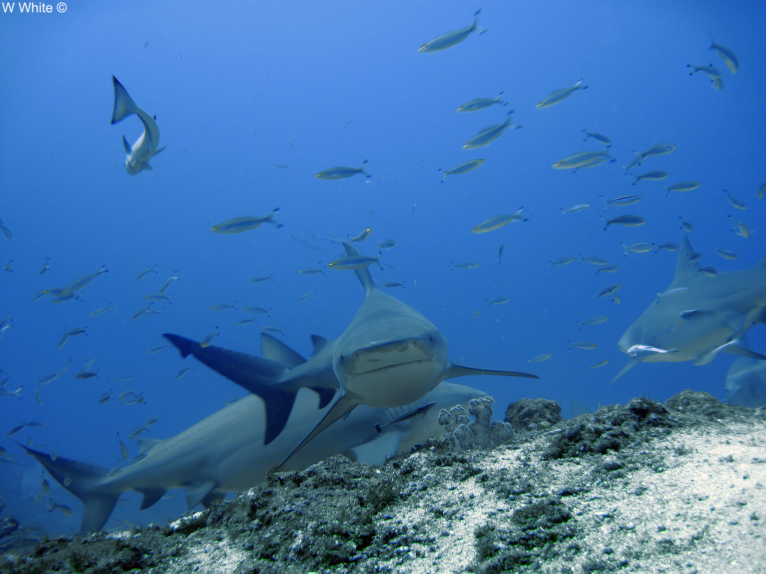
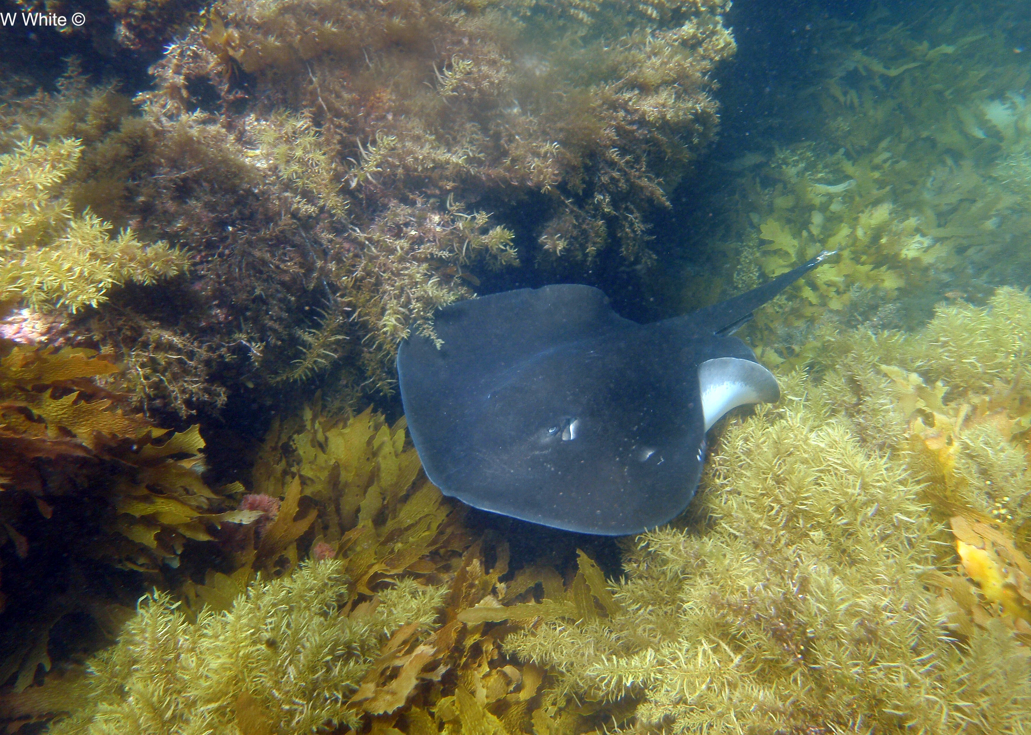

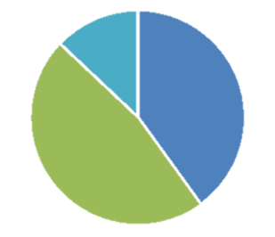
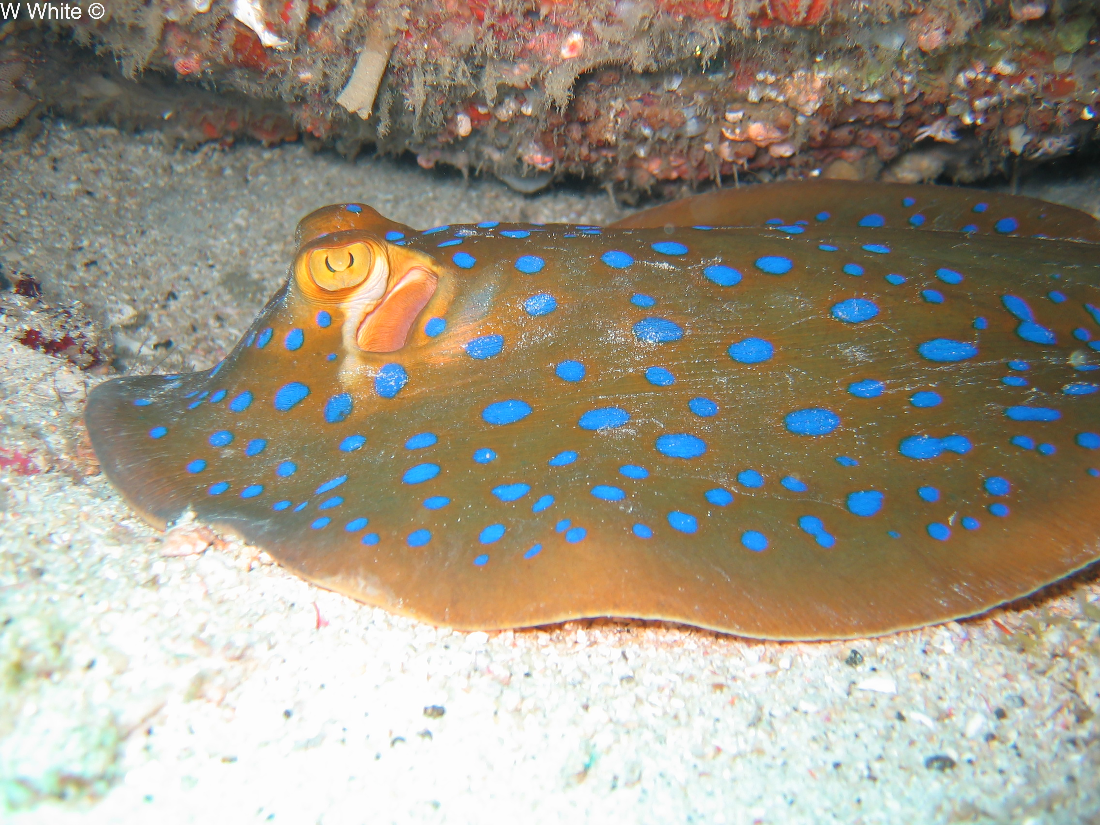
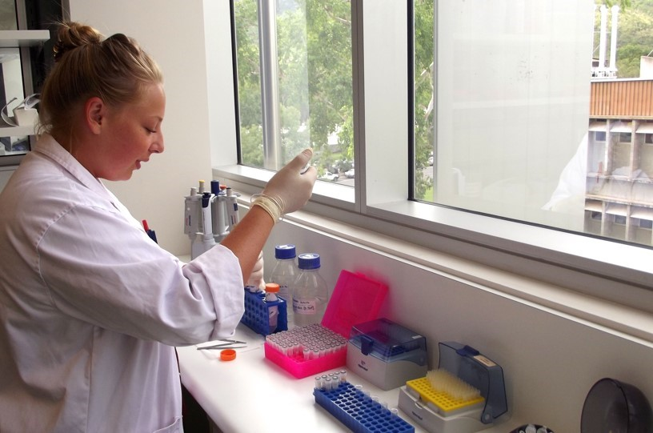

Heather Moore
Elizabeth MacCready
Molly Ostheller
Problem
Process
Solution
A majority of shark and ray species are data deficient.
Collaboration and sample sharing between researchers is hampered by distance and
lack of communication opportunities.
This results in wasted samples, and
wasted research opportunities.
Gathering our requirements, we learned that our audience is:
Comfortable with basic computer functionality
Storing data in spreadsheet formats
Not used to online research collaboration and concerned about the sample-sharing process.
We needed to maximize reach, minimize maintenance, and run on low cost.
We needed a low barrier for adoption for both the audience and our sponsor.
We needed to set scope boundaries early to accommodate our small team size.
Web app that allows for collaboration between scientists.
Attribution of work and samples were at the forefront of the sharing process.
Reduces anxiety about sharing and collaboration by:
Putting attribution of work and sample ownership at the forefront.
Mimicking existing processes (storage, communication) that researchers are used to, while ‘supercharging’ them with the new database.
The site is cloud hosted for global accessibility through Amazon Web Services, and is custom built using MySQL and PHP on a Twitter Bootstrap framework.
Data Deficient
Data Sufficient
Of 2,041 species
(Human-Threatened)
Next Steps
Shark Share will go live for researcher use this summer.
Leveraging the sponsor’s presence and activity in relevant social media networks, they hope to grow their user base significantly in the next year.
The taxonomy will continue to be updated through the interface built to reflect changes in the field.
Shark Share will promote the application at a series of conferences throughout the summer.
Our Sponsor
Shark Share Global was founded by Madi Green and Lauren Meyer for the purpose of fostering global collaboration amongst their fellow shark scientists. Funding for the project
was provided by a generous grant
from the Save our Seas Foundation.

